Slide 1
Kudo Icons
Starter objects(blue)

Slide 2
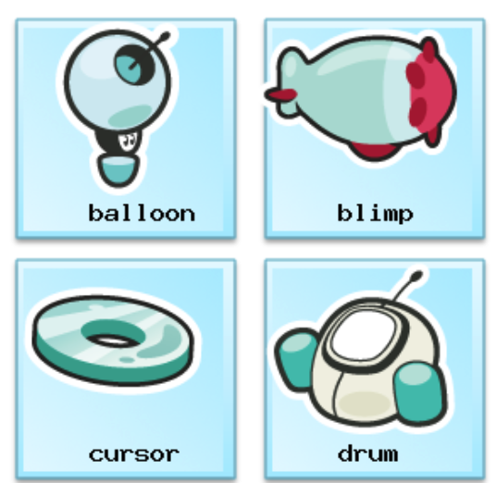
Guess the icon

Slide 3
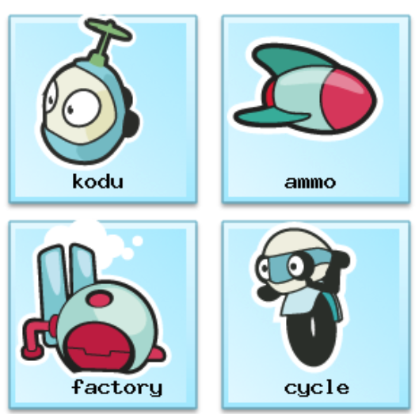
Guess the icon

Slide 4
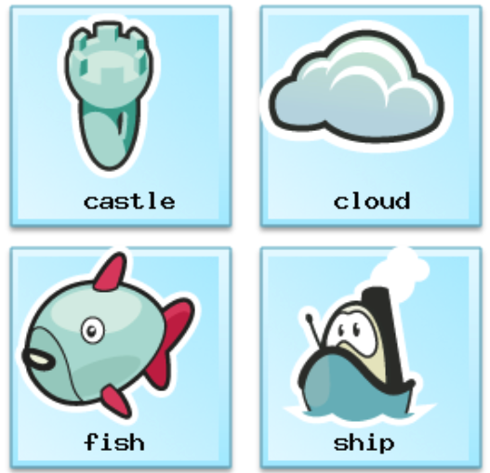
Guess the icon

Slide 5
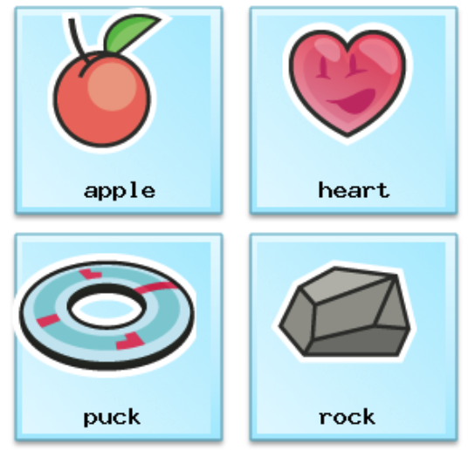
Guess the icon

Slide 6
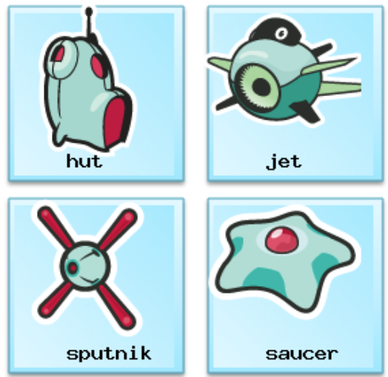
Guess the icon

Slide 7
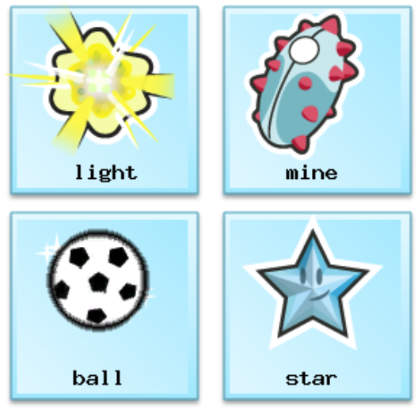
Guess the icon

Slide 8

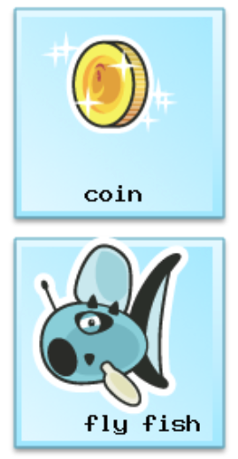
Guess the icon

Slide 9


Guess the icon

